Slide 1
Entity Framework Going Further with Mapping

Slide 2
Contents
Mapping scenarios
Table Per Hierarchy (TPH)
Table Per Type (TPT)
Table Per Concrete Type (TPC)
Demos folder:
Demos-D-EFMapping

Slide 3
1. Mapping Scenarios
Overview
Scenario

Slide 4
Overview
The Entity Framework provides 3 techniques that allow you to map inheritance hierarchies to database table(s)
Table Per Hierarchy
Table Per Type
Table Per Concrete Type
We'll explore all 3 techniques in this chapter
See the DemoInheritance demo project
We'll be using a code-first approach, i.e. the database tables will be generated from our POCO classes
If you prefer, you can use database-first or model-first

Slide 5
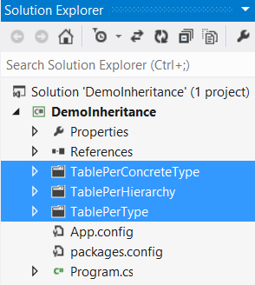
Scenario
We'll show 3 completely separate code examples, to illustrate each technique
See the separate folders in the project
All the examples will use the same basic object model:
{abstract}
Person
Employee
Customer

Slide 6
2. Table Per Hierarchy (TPH)
Overview of TPH
Pros and cons of TPH
Defining entity classes for TPH
Defining a context class for TPH
Executing polymorphic queries for TPH
Executing non-polymorphic queries for TPH

Slide 7
Overview of TPH
With TPH, you map an entire class hierarchy to a single table
Table has columns for all properties of all classes in the hierarchy
How does it work?
The table has a special discriminator column, which indicates the type of object housed in that row
Each concrete subclass has a different discriminator value
TPH is the default mapping strategy in Code First
The discriminator column is a string column named "Discriminator"
Code First automatically sets and retrieves discriminator values

Slide 8
Pros of TPH
Best performance
TPH is the best-performing way to represent polymorphism, i.e. where you want to select several types of object in the same query
This is because there's no need for any joins or unions to pull in different types of data – everything is in the same table already!
Simplicity
TPH is a very simple!
Schema evolution is straightforward

Slide 9
Cons of TPH
Nullable properties
Columns for all the properties in concrete subclasses must be defined as nullable – why?
Not normalized
TPH causes functional dependencies between non-key columns
Violates the Third Normal Form

Slide 10
Defining Entity Classes for TPH
Here are the entity classes for TPH
Just define a normal inheritance hierarchy!
public abstract class PersonTph
{
public int PersonTphID { get; set; }
public String Name { get; set; }
public String Address { get; set; }
…
} TablePerHierarchy/PersohTph.cs
public class EmployeeTph : PersonTph
{
public DateTime JoiningDate { get; set; }
public decimal Salary { get; set; }
…
} TablePerHierarchy/EmployeeTph.cs
public class CustomerTph : PersonTph
{
public bool CreditWorthy { get; set; }
public int NumPurchases { get; set; }
…
} TablePerHierarchy/CustomerTph.cs

Slide 11
Defining a Context Class for TPH
The context class is very straightforward
Contains a single DbSet, for the base class
Doesn't contain DbSet's for the subclasses – Code First will find the subclasses automatically, based on "reachability convention"
Note:
Also see TablePerHierarchy/MyInitializerTph.cs
Seeds the database with employee and customer records
public class MyContextTph : DbContext
{
public DbSet<PersonTph> PersonTphs { get; set; }
} TablePerHierarchy/MyContextTph.cs

Slide 12
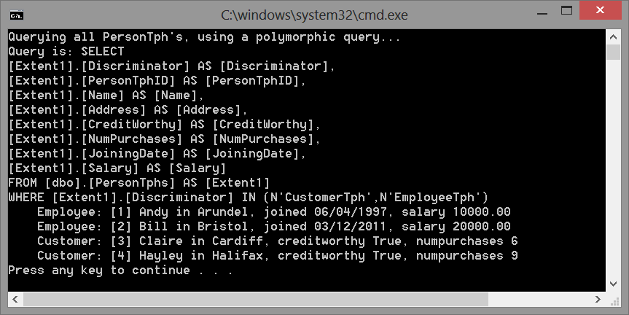
Executing Polymorphic Queries for TPH
Here's an example of a polymorphic query
Gets all types of person
Creates Employee or Customer entities, based on discriminator
private static void PolymorphicQuery() TablePerHierarchy/DemoTph.cs
{
using (var context = new MyContextTph())
{
Console.WriteLine("Querying all PersonTph's, using a polymorphic query...");
IQueryable<PersonTph> query = from p in context.PersonTphs select p;
Console.WriteLine("Query is: " + query.ToString());
foreach (var p in query)
{
Console.WriteLine(p);
}
}
}

Slide 13
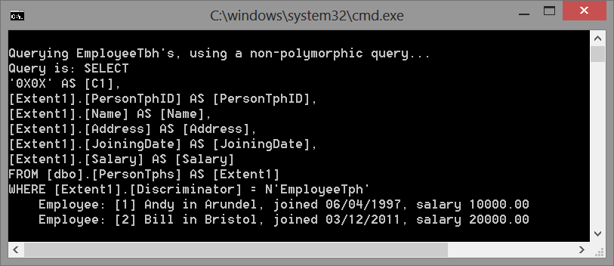
Executing Non-Polymorphic Queries for TPH
Here's an example of a non-polymorphic query
Gets a specific type of person, via OfType<T>()
Causes a query that switches on the discriminator value
private static void NonPolymorphicQuery() TablePerHierarchy/DemoTph.cs
{
using (var context = new MyContextTph())
{
Console.WriteLine("\nQuerying EmployeeTbh's, using a non-polymorphic query...");
IQueryable<EmployeeTph> equery =
from e in context.PersonTphs.OfType<EmployeeTph>() select e;
Console.WriteLine("Query is: " + equery.ToString());
foreach (var e in equery)
{
Console.WriteLine(" " + e);
}
// Ditto for customers.
}
}

Slide 14
3. Table Per Type (TPT)
Overview of TPT
Pros and cons of TPT
Defining entity classes for TPT
Defining a context class for TPT
Executing polymorphic queries for TPT
Executing non-polymorphic queries for TPT
Polymorphic associations for TPT

Slide 15
Overview of TPT
With TPT, you map every abstract/concrete class that has persistent properties to a separate table
Uses relational FKs to join base-class and sub-class tables together
For the base class:
Define a table that contains the common properties
Define a PK column (obviously)
For each subclass:
Define a separate table, with properties just for that subclass
Define a PK column, which is also a FK to the base class table (Code First will generate this PK/FK column automatically)
Allows a subclass row to be joined with the appropriate base-class row, to create a subclass entity in memory

Slide 16
Pros of TPT
Best performance
The SQL schema is normalized
Schema evolution is straightforward – if you modify the base class, you can just add another property to the base-class table
Easy to add new subclasses
Just add another subclass table
Integrity is better than TPH
No need for null columns everywhere

Slide 17
Cons of TPT
Slower than TPT
Performance can be unacceptable for complex class hierarchies because queries always require a join across many tables
Ad-hoc reporting is quite complex

Slide 18
Defining Entity Classes for TPT (1 of 2)
Here are the entity classes for TPT
You must annotate subclasses with [Table], to indicate each subclass maps to a separate table now
public abstract class PersonTpt
{
public int PersonTptID { get; set; }
public String Name { get; set; }
public String Address { get; set; }
…
} TablePerType/PersonTpt.cs
[Table("EmployeesTpt")]
public class EmployeeTpt : PersonTpt
{
public DateTime JoiningDate { get; set; }
public decimal Salary { get; set; }
…
} TablePerType/EmployeeTpt.cs
[Table("CustomersTpt")]
public class CustomerTpt : PersonTpt
{
public bool CreditWorthy { get; set; }
public int NumPurchases { get; set; }
…
} TablePerType/CustomerTpt.cs

Slide 19
Defining Entity Classes for TPT (2 of 2)
You can also define polymorphic associations
E.g. a company can keep track of all its employees and customers
In the database:
A row in the CompanyTpt table will have a FK that points to a row in the PersonTpt table…
… which will be joined with a row in either the EmployeeTpt or CompanyTpt table, to represent an employee or customer
public class CompanyTpt
{
public int CompanyTptID { get; set; }
public string CompanyName { get; set; }
public virtual List<PersonTpt> KnownPeople { get; set; }
…
} TablePerType/CompanyTpt.cs

Slide 20
Defining a Context Class for TPT
The context class is basically the same as for TPH
Only define a DbSet for the base class, not for subclasses
Note, we've also defined a DbSet for our "company" entity too in this example
Note:
Also see TablePerType/MyInitializerTpt.cs
Seeds database with employee, customer, and company records
public class MyContextTpt : DbContext
{
public DbSet<PersonTpt> PersonTpts { get; set; }
public DbSet<CompanyTpt> CompanyTpts { get; set; }
} TablePerType/MyContextTpt.cs

Slide 21
Executing Polymorphic Queries for TPT (1)
Here's an example of a polymorphic query
Gets all types of person
Creates Employee or Customer entities, using joins and unions
See next slide for the generated SQL
private static void PolymorphicQuery() TablePerType/DemoTpt.cs
{
using (var context = new MyContextTpt())
{
Console.WriteLine("Querying all PersonTpt's, using a polymorphic query...");
IQueryable<PersonTpt> query = from p in context.PersonTpts select p;
Console.WriteLine("Query is: " + query.ToString());
foreach (var p in query)
{
Console.WriteLine(" " + p);
}
}
}

Slide 22
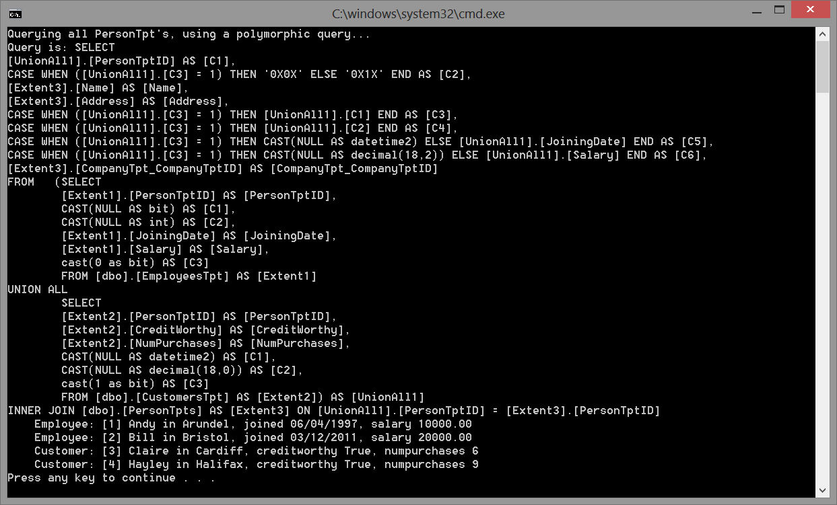
Executing Polymorphic Queries for TPT (2)
Here's the SQL and output for the polymorphic query

Slide 23
Executing Non-Polymorphic Queries for TPT (1)
Here's an example of a non-polymorphic query
Gets a specific type of person, via OfType<T>()
Causes a query that switches on the discriminator value
See next slide for the generated SQL
private static void NonPolymorphicQuery() TablePerTable/DemoTpt.cs
{
using (var context = new MyContextTpt())
{
Console.WriteLine("\nQuerying EmployeeTpt's, using a non-polymorphic query...");
IQueryable<EmployeeTpt> equery =
from e in context.PersonTpts.OfType<EmployeeTpt>() select e;
Console.WriteLine("Query is: " + equery.ToString());
foreach (var e in equery)
{
Console.WriteLine(" " + e);
}
// Ditto for CustomerTpt's …
}
}

Slide 24
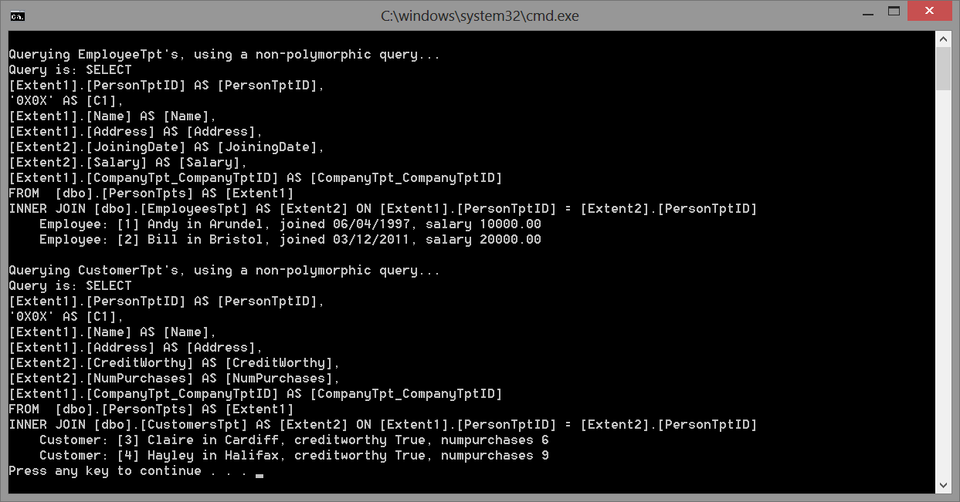
Executing Non-Polymorphic Queries for TPT (2)
Here's the SQL and output for the non-polymorphic query

Slide 25
Polymorphic Associations for TPT (1)
Here's an example of traversing a polymorphic association
Gets all the employees and customers for a company
See next slide for the generated SQL
private static void PolymorphicAssociation() TablePerType/DemoTpt.cs
{
using (var context = new MyContextTpt())
{
Console.WriteLine("\nQuerying all CompanyTpt's and their known people...");
IQueryable<CompanyTpt> query = from co in context.CompanyTpts select co;
Console.WriteLine("Query is: " + query.ToString());
foreach (var co in query)
{
Console.WriteLine("Company {0} has {1} known people:", co.CompanyName,
co.KnownPeople.Count);
foreach (var p in co.KnownPeople)
{
Console.WriteLine(" " + p); // This will be an employee or customer!
}
}
}
}

Slide 26
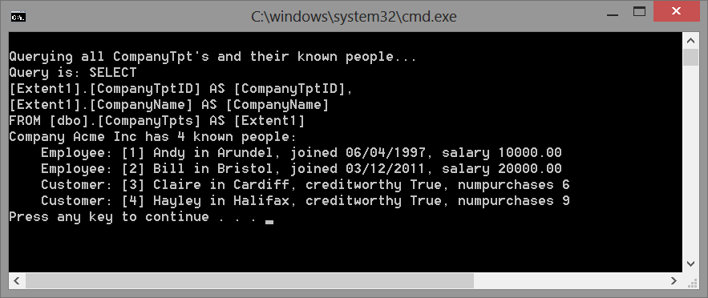
Polymorphic Associations for TPT (2)
Here's the SQL and output for the polymorphic association query

Slide 27
4. Table Per Concrete Type (TPC)
Overview of TPC
Pros and cons of TPC
Defining entity classes for TPC
Defining a context class for TPC
Executing polymorphic queries for TPC
Executing non-polymorphic queries for TPC

Slide 28
Overview of TPC
You define exactly one table for each non-abstract class
All properties of the class, including inherited properties, are mapped to properties of a specific table
How does it work?
The properties of the base class appear explicitly in each subclass table (i.e. there is duplication of columns across tables)
Each subclass is completely represented by its own single table
Note, there is no SQL relationship between base classes or subclasses
No FKs!

Slide 29
Pros of TPC
Relatively good performance
If you execute a polymorphic query, a UNION occurs to get rows from each subclass table
UNIONs are faster than JOINs, so TPC is faster than TPT

Slide 30
Cons of TPC
Polymorphic associations don't work
In the database, associations are represented as FK relationships…
But in TPC, the subclasses are all mapped to different tables…
So a polymorphic association to their base class can't be represented as a simple FK relationship
Schema evolution is complex
Several different columns, of different tables, share exactly the same semantics
So if you change a base class property, you must ripple the change through all subclass tables
PK management is tricky
You must ensure each row in every table has a different PK
E.g. employee PKs must be different to customer PKs, etc.

Slide 31
Defining Entity Classes for TPC
Here are the entity classes for TPC
Just like TPT, we need a separate table for each subclass
Now though, we must suppress automatic generation of PKs in the base class – instead, each subclass instance must set its PK manually, to ensure each row in each table has a different PK!
public abstract class PersonTpc
{
[DatabaseGenerated(DatabaseGenerationOption.None)]
public int PersonTpcID { get; set; }
public String Name { get; set; }
public String Address { get; set; } …
… TablePerConcreteType/PersohTpc.cs
public class EmployeeTpc : PersonTpc
{
public DateTime JoiningDate { get; set; }
public decimal Salary { get; set; }
… TablePerConcreteType/EmployeeTpc.cs
public class CustomerTpc : PersonTpc
{
public bool CreditWorthy { get; set; }
public int NumPurchases { get; set; }
… TablePerConcreteType/EmployeeTpc.cs

Slide 32
Defining a Context Class for TPC
In the context class, we must tell Code First:
Each subclass table should contain all the inherited properties
What name to use for each subclass
Note:
Also see TablePerConcreteType/MyInitializerTpc.cs
We must set each PK field explicitly, to ensure they're all unique
public class MyContextTpc : DbContext
{
public DbSet<PersonTpc> PersonTpcs { get; set; }
protected override void OnModelCreating(DbModelBuilder modelBuilder)
{
modelBuilder.Entity<CustomerTpc>().Map(m => {
m.MapInheritedProperties();
m.ToTable("CustomersTpc");
});
modelBuilder.Entity<EmployeeTpc>().Map(m => {
m.MapInheritedProperties();
m.ToTable("EmployeesTpc");
});
}
} TablePerConcreteType/MyContextTpc.cs

Slide 33
Executing Polymorphic Queries for TPC (1)
Here's an example of a polymorphic query
Gets all types of person
Executes a UNION to merge records from separate subclass tables
private static void PolymorphicQuery() TablePerConcreteType/DemoTpc.cs
{
using (var context = new MyContextTpc())
{
Console.WriteLine("Querying all PersonTpc's, using a polymorphic query...");
IQueryable<PersonTpc> query = from p in context.PersonTpcs select p;
Console.WriteLine("Query is: " + query.ToString());
foreach (var p in query)
{
Console.WriteLine(" " + p);
}
}
}

Slide 34
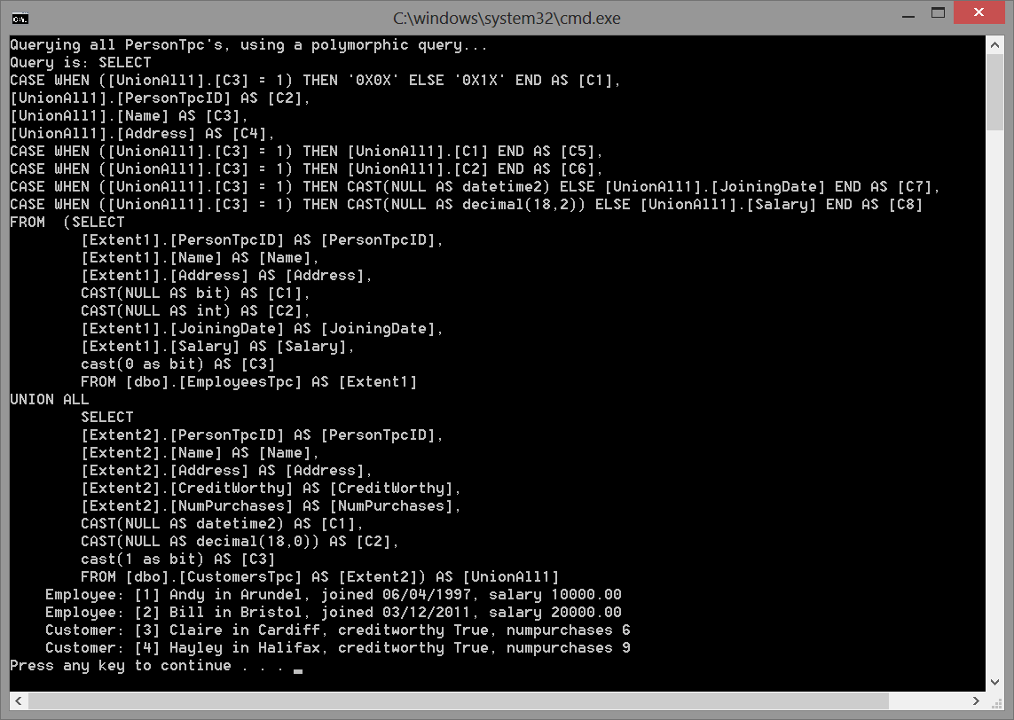
Executing Polymorphic Queries for TPT (2)
Here's the SQL and output for the polymorphic query

Slide 35
Executing Non-Polymorphic Queries for TPC (1)
Here's an example of a non-polymorphic query
Gets a specific type of person, via OfType<T>()
Causes a query that switches on the discriminator value
private static void NonPolymorphicQuery() TablePerConcreteType/DemoTpc.cs
{
using (var context = new MyContextTpc())
{
Console.WriteLine("\nQuerying EmployeeTpc's, using a non-polymorphic query...");
IQueryable<EmployeeTpc> equery =
from e in context.PersonTpcs.OfType<EmployeeTpc>() select e;
Console.WriteLine("Query is: " + equery.ToString());
foreach (var e in equery)
{
Console.WriteLine(" " + e);
}
// Ditto for customers…
}

Slide 36
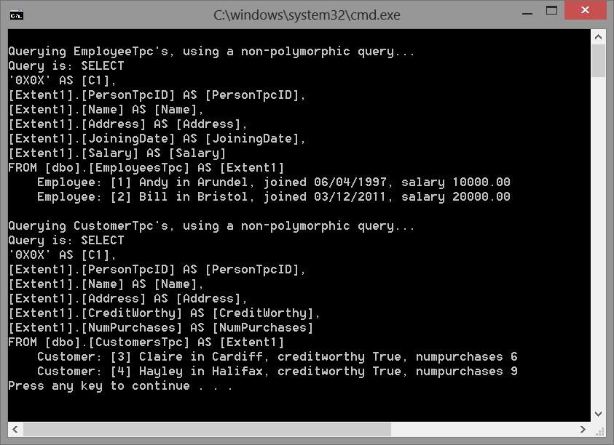
Executing Non-Polymorphic Queries for TPC (2)
Here's the SQL and output for the non-polymorphic query

Slide 37
Summary
If you don’t require polymorphic associations or queries:
Probably use TPC
Especially suitable for the top level of the hierarchy, where polymorphism isn’t usually required
If you do require polymorphic associations or queries, and subclasses declare relatively few properties:
Probably use TPH
But all those nullable columns might cause problems long-term
If you do require polymorphic associations or queries, and subclasses declare many properties:
Probably use TPT
Or, depending on the width/depth of your hierarchy and the possible cost of joins versus unions, maybe use TPC

Slide 38
Any Questions?

